Slide 1
17- Arrays

Slide 2
context
about “array” data type 3
array(typecode, listObject) 4
Typecode 5
all the typecode in Python 6
Add a new item to a List object
arrayObject.append(anObject) 7
arrayObject.insert(index) 8
access individual items in a list
listObject[index] 9
Ex.1 10

Slide 3
about “array” data type
use arrays only if you're dealing with
a large sequence of numbers and
you encounter performance problems,
take less memory and
perform a little bit faster
Note: you will see the difference only if you're dealing with a large list of numbers, let's say 10,000 or more
If you don't have any performance problems don't try to optimize. In other words, don't solve a problem that doesn't exist.
for other cases use lists and tuples by default.

Slide 4
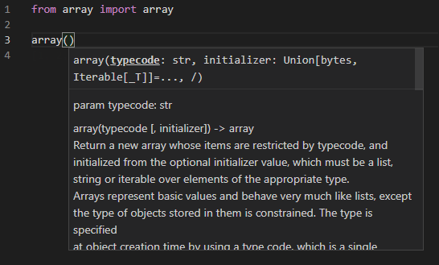
array(typecode, listObject)
a module called array
in this module we have a class called array.

Slide 5
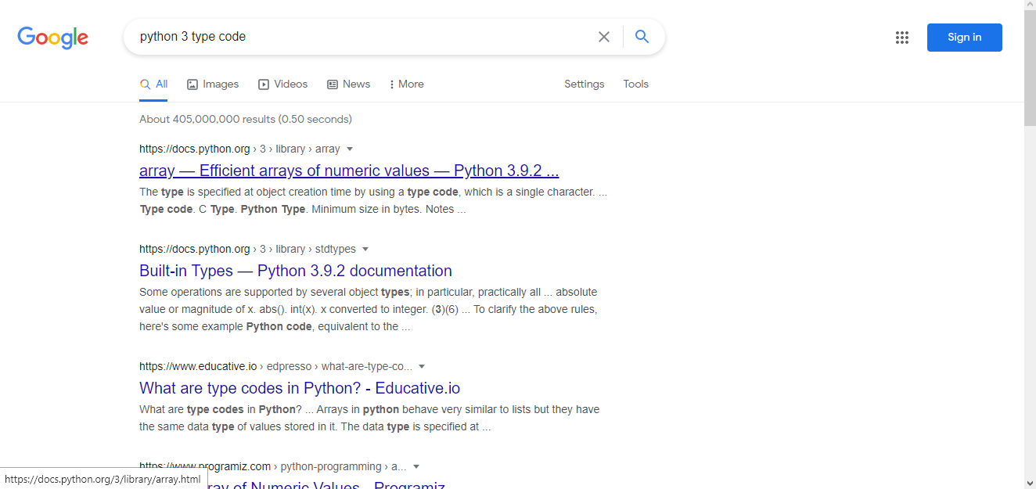
typecode
In google search for this: python 3 type code

Slide 6
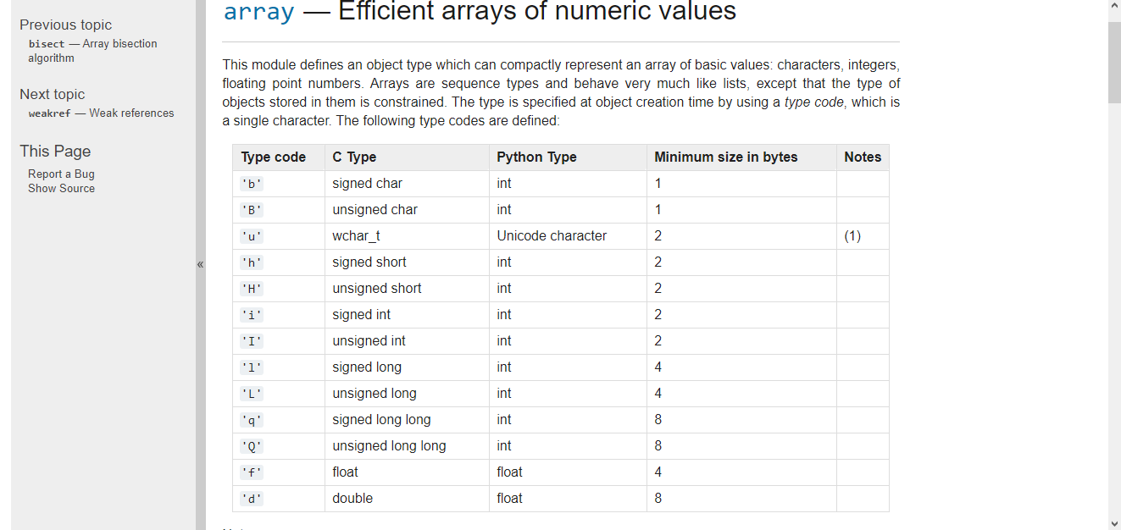
all the typecode in Python
So it's a string of one character that determines the type of objects in your array.

Slide 7

arrayObject.append(anObject)
to append a number to the end of the list

Slide 8
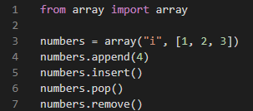
arrayObject.insert(index)
to add a number at a specific index

Slide 9
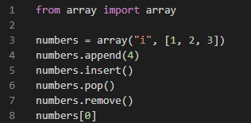
access individual items in a list listObject[index]

Slide 10

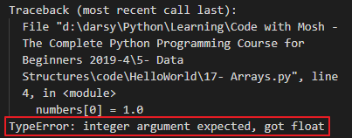
Ex.1
However unlike lists, the objects in this array are tight. So here every object should be an integer.
every object in this array should be of the same type. which is determined at the time of creating the array using the typecode.

